Slide 1
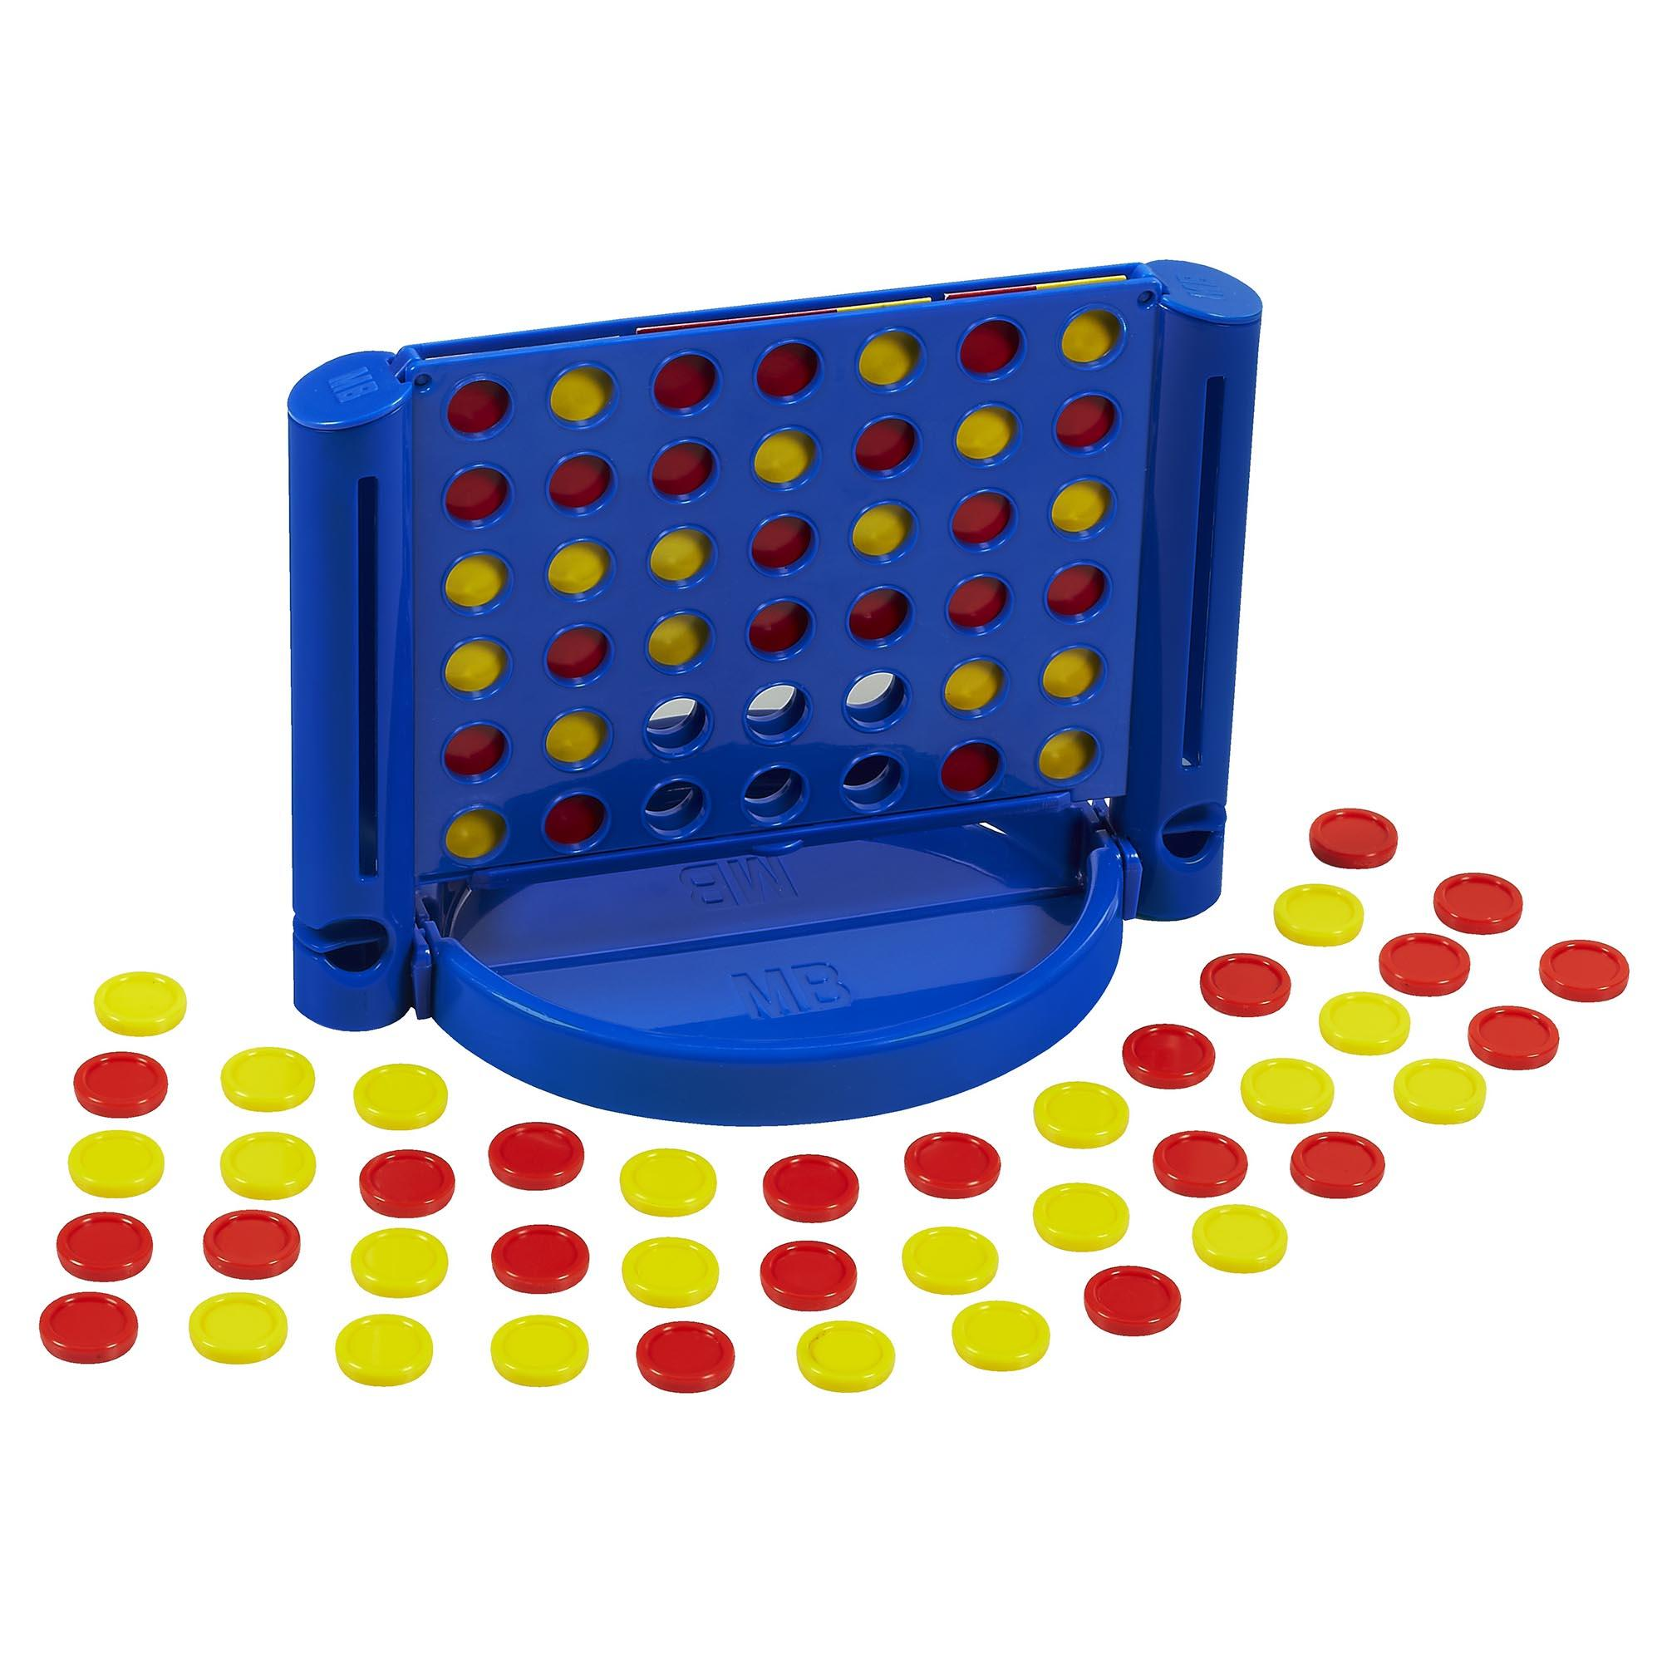
Connect 4
David Betteridge
Notes:
Picture is wrong!

Slide 2
The classic game
One player is red, the other yellow
Players take it in turns to place a counter into a column
Yellow goes first
The first player to get 4 in a row (vertically, horizontally or diagonally) wins
The board is 7 columns by 6 rows
Notes:
Could add animation

Slide 3
Your Challenge
Write a bot to win a game of connect 4
The bot runs on your machine but calls a set of (simple) APIs on the server.
The API calls are made using http GET and POST commands

Slide 4
The Steps
Choose a name (and password) for your team. Then ‘Post’ to Register
Then ‘Get’ the current state of the game. This will include the board and whose turn it is.
If it is your turn then make your move
Repeat from step 2

Slide 5
Getting Started Templates
C# - https://github.com/YorkCodeDojo/Connect4/tree/master/Connect4.ExampleBot
C++ - https://github.com/YorkCodeDojo/Connect4/tree/master/Connect4.C++
Type script - https://github.com/YorkCodeDojo/Connect4/tree/master/js
Python - https://github.com/YorkCodeDojo/Connect4/tree/master/pythonExample
Kotlin - https://github.com/AndyBowes/konnect4client
Notes:
These are on the hand outs

Slide 6
URLS
View games
http://yorkdojoconnect4.azurewebsites.net/
Documentation
http://yorkdojoconnect4.azurewebsites.net/Swagger
APIs
http://yorkdojoconnect4.azurewebsites.net/api/
Notes:
Some URLs you will need

Slide 7
/api/Register [POST]
Register your team and returns your unique player ID.
Parameters:
TeamName
Password
Returns:
Your player ID
Example
api/Register?teamName=Winners&password=Secret
Notes:
Is there anyone who wants to use a different language?

Slide 8
/api/GameState [GET]
Returns the current state of the game
Parameters:
PlayerID
Returns:
A json object shown on the next slide
Example
api/GameState?playerID=1234567

Slide 9
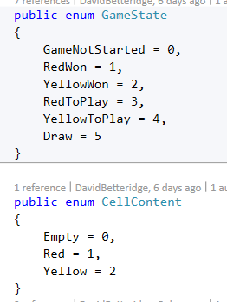
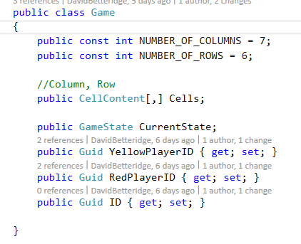
Game Object
Notes:
0,0 is bottom left
7 columns
6 rows

Slide 10
/api/MakeMove [POST]
Places your piece into a column
Parameters:
PlayerID
ColumnNumber
Password
Returns:
Nothing
Example
api/MakeMove?playerID=1234567&ColumnNumber=2&Password=secret

Slide 11
/api/NewGame [POST]
Clears the board
Parameters:
PlayerID
Returns:
Nothing
Example
api/NewGame?playerID=1234567

Slide 12
Techniques
Random Play
Systematic (left to right)
Logical thinking
Minimax
Minimax with Alpha-Beta pruning
Monte Carlo Search
Monte Carlo Tree Search
Notes:
You can take what ever approach you wish, but here are some suggestions:
Logical thinking – if I play here, then I will lose

Slide 13










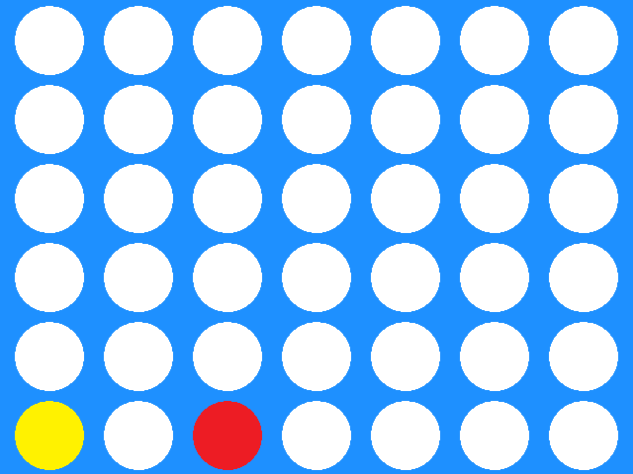

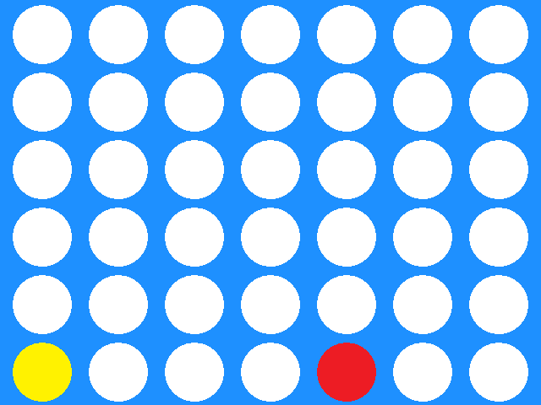
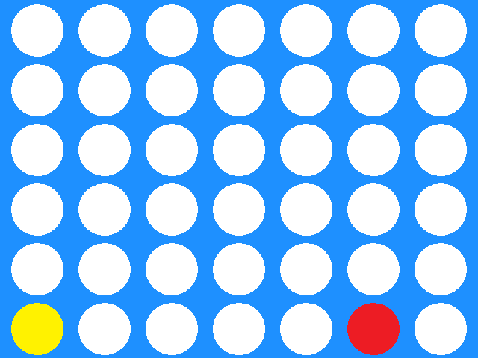

Possible Moves
Branching Factor = 7
Yellow to play
Depth = 42
Red To Play
Notes:
Total number of possible games is 7 * 7 * ….7 with is 7 ^ 42 (well slightly less but still lots)
These are too many to try out in your turn. So you can either just examine all the moves to a given depth (Mini-max)
Of you can examine a selection of moves to their completion (Monte carlo search)

Slide 14
Minimax
Notes:
Build the tree to a fixed depth. The deeper the better but takes longer to calculate
Assign each terminal node a score. A big +ve score for a win, a big –ve score for a lose, and 0 for a draw
Take the largest values
Nodes without children must be terminal nodes. Let’s say these were all draws but this was a win for yellow
Then take the smallest values
And then the largest
So the best red can hope for is a draw
The challenge is a good scoring algorithm

Slide 15
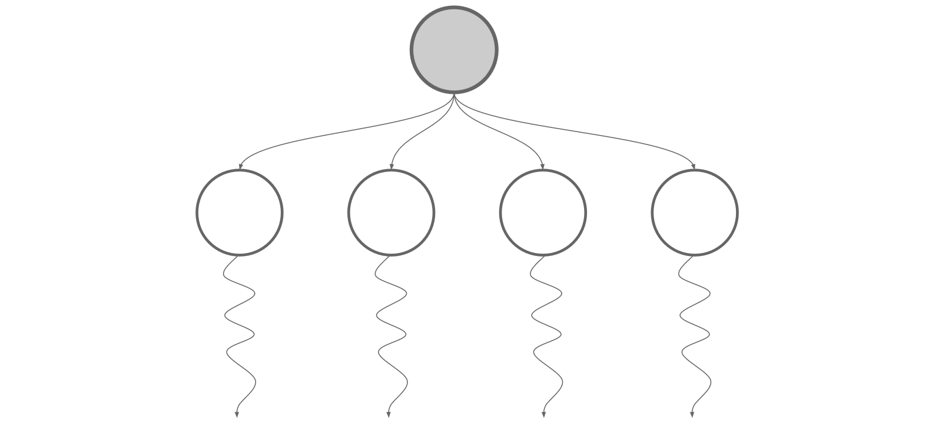
Monte Carlo Search
Notes:
Simplified!
Play all possible moves to give depth
From there play a set of random games till their completion
From the root node, work out which initial move won the most games on the average
Play that move
Requires no knowledge of the game
The more random games you play the better the move
Not are strong as Mini-max
Can you Monte Carlo tree search to give better results

Slide 16
Exercises
Pair Up
Play against the server
Show / Contest?
Pub
Notes:
Time permitting

